Slide 1

Smart customer care
Team Members
Ahmed Abbas
Fakhr Mahmoud
Mohamed Anwar
Karim Omar
Mohamed Refaie
Supervised by
Dr. Walaa Medhat
Eng. Ali Abdel Razik
1

Slide 2
TABLE OF CONTENTS
01
02
03
Recap
Importance of customer loyalty
Gathering Data
04
05
06
Our Solution
Related Software in the Market
What We Do Better
07
06
Milestones
References
07
Summary
2
2

Slide 3
Recap
Customers nowadays don’t build their trust just on the price of product, but on the experience they receive.
This project seeks to help corporations to improve their products & services by improving on customers’ opinions.
The software collects customer’s opinions off social media and analyzes it for useful information, which attracts huge investments.
3

Slide 4


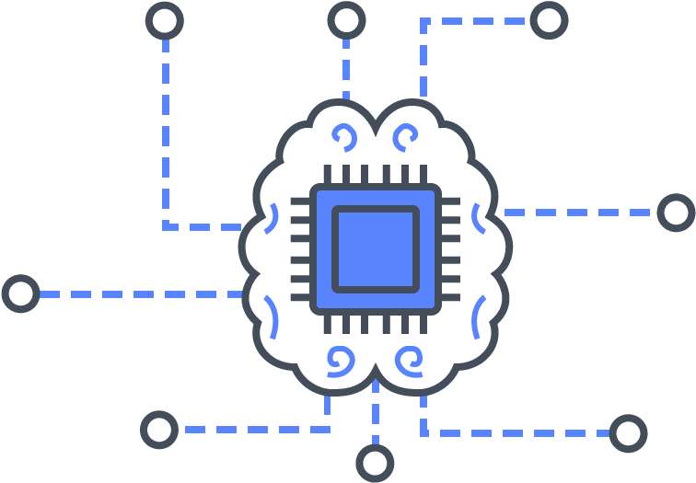

Scrapping
Apply
Social Media
Natural Language
Processing
Websites
4

Slide 5
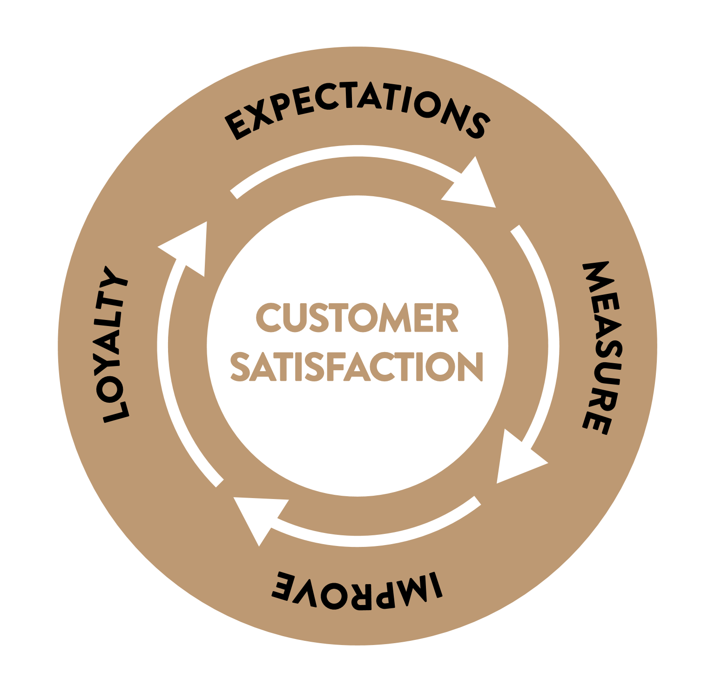
Impact of Customer Satisfaction
How Important Is Customer Satisfaction? Quantitative Evidence from Mobile Telecommunication Market.
Study by University of Kuala Lumpur Business School
The study explores whether customer satisfaction affects the relationship between customer loyalty and service
quality, and between customer loyalty and perceived value.
The result was a positive correlation between Good Service, Customer Satisfaction and Loyalty, and overall corporation success.
5

Slide 6
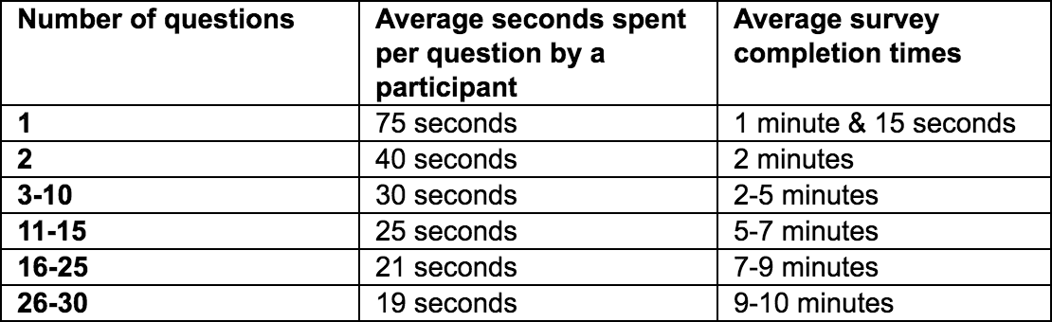
Gathering Customer Opinions
Long-Form Survey
Phone Calls
The person calling the user should genuinely want to understand their problem and offer solutions.
Very time consuming
Lacks diversity
6
4

Slide 7
Social Media’s Customer Opinion
Social Customer Relationship Management (SCRM): How Connecting Social Analytics to Business Analytics Enhances Customer Care and Loyalty?
Marketing, School of Business National University
This study investigates how Social Media (SM) has become an undeniable influence on customer care.
This study examined three main questions:
How companies can leverage SM to strengthen customer care
How SM channels enhances customer loyalty
What are the managerial and profit implications of these findings for managers and researchers.
7

Slide 8

Additional Information
Corporations hire social media teams
Corporations invest in tools necessary to track shifts in loyalty
Corporations invest in automated listening, “cleaning” and analytic tools to replace actual social media teams.
8

Slide 9
Our Methods of Extracting Data
Data and opinions are gathered off Social Media.
Reading customers’ comments and opinions is automated, saving labor cost.
Target audience:
Users of poor or no automated systems
Who wish to transfer from team-based SM to automated system
9

Slide 10
Related Software in the Industry
Social Media Analyzer (This Project’s Category)
This type of software focuses on analyzing data scraped from social media websites
Discovers people’s relative opinions and topics on certain products or services.
Companies use this data to learn and implement future improvements.
10

Slide 11

Twitter Emotion Analyzer
Scrapes tweets on twitter and identifies whether it is a negative or positive comment with priorities
The scraping criteria focused on tweets from the accounts of four U.S telecom companies:
AT&T
T-Mobile
Verizon
Sprint
11

Slide 12

Benefits:
Identified users with problems quickly for moderators to respond to
Those with more severe sentiment levels were prioritized
12

Slide 13
Issues:
Lacks platform diversity as its only source of data is Twitter (limited population reached)
lacks international relevancy as it only tracks tweets from US companies
Scraping criteria cannot be reconfigured
Can only identify emotions (Cannot apply classification)
Website attempts to block scraping tools (High Maintenance factor)
13

Slide 14
Related Software in the Industry
Chatbots
One of the main recent methods of using Software systems to collect data about customer experience are smart chatbots.
Chatbots are used to automate customer communication to solve trivial or otherwise simple enquiries fast and efficiently.
Most chat bots make use of expert systems and utilize machine learning to identify patterns quicker
14

Slide 15
Main Chatbots Advantages:
Mostly Available 24/7
Frees up Customer Service Agents.
Instant and consistent responses
15

Slide 16

Main Chatbots Disadvantages:
They require constant maintenance due to frequent system changes
Can’t handle complex enquiries.
Difficult to create and optimize.
16

Slide 17




The Big Four :
There are currently four main chatbots in the industry:
Microsoft Azure.
Amazon Polly.
IBM Watson.
Google Cloud Text-to-Speech.
17

Slide 18
What We Do Better
Data Gathering & Analysis
We scrape data off multiple social media sites therefore reaching a wider population and increasing the data we feed our models
Generic search criteria where through our user interface the consumer can gather data on exactly what they’re looking for
Utilize natural language processing to interpret and classify detailed customer comments
18

Slide 19
Expected Milestones
Stage 1:
Data collection by web scraping data from social media sites
(Facebook currently)
We hope to have this stage completed by the end of January.
Stage 3:
Determining the models required to be used for our system and applying them
Deciding on the machine learning models needed for our system is our planned next step after data-collection is done.
We hope to have this stage done by no later than April.
Stage 2:
Building data cleaning algorithms and preprocessing
Such algorithms are needed to filter out irrelevant data obtained during the first stage.
Collected data will -hopefully- be fully cleaned as soon as March.
Stage 4:
Implementing UI designs and functionality on supported platforms
Final stage of our system implementation; estimated completion during May.
19

Slide 20

References
IBM Artificial Intelligence.
Build your Own Chatbot for Good.
Modern Web Scraping with Python using Scrapy.
MongoDB crash course.
developer.ibm.com/digitalnation/africa/course/innovator-chatbot-for-good/overview?
developer.ibm.com/digitalnation/africa/course/innovator-chatbot-for-good/overview?
udemy.com/course/web-scraping-in-python-using-scrapy-and-splash/
university.mongodb.com/courses/M001/about
radimrehurek.com/gensim/auto_examples/index.html
Gensim Documentation
20

Slide 21
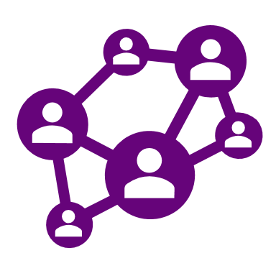
References
How Important Is Customer Satisfaction? Quantitative Evidence from Mobile Telecommunication Market.
An Intelligent Customer Care Assistant System for Large-Scale Cellular Network Diagnosis
Real World Smart Chatbot for Customer Care using a Software as a Service (SaaS) Architecture
Social Customer Relationship Management (SCRM): How connecting social analytics to business analytics enhances customer care and loyalty?
DOI: 10.5539/ijbm.v11n6p57
Social Customer Relationship Management
https://carlsonschool.umn.edu/sites/carlsonschool.umn.edu/files/inline-files/sde_isr_new_v3_0.pdf4
https://sci-hub.se/10.1145/3097983.3098120
https://sci-hub.se/10.1109/i-smac.2017.8058261
https://sci-hub.se/10.1287/isre.2019.0889
Social Customer Relationship Management (SCRM): How connecting social analytics to business analytics enhances customer care and loyalty?
The Voice of the Customer: Managing Customer Care in Twitter
21

Slide 22


Project Repositories
(Scraping) https://github.com/KarimBastami/Scrapy_News_Scraper
(Topic Modelling Trial) https://colab.research.google.com/drive/1PEHwcG6ANbYES2PFX5NRFOoAOSUrCpOO?usp=sharing
GitHub
Google Collab
22

Slide 23

Summary
Our project is an automated customer care service
Customer Loyalty impacts overall profits
Social Media is a great medium of gathering opinions
Our projects gather data off Social Media and analyzes it.
Related software in the market includes
Social Media Analyzer
Twitter Emotion Analyzer
Smart chatbots
Our product gathers data from multiple social media sites
Uses natural language processing to classify data into understandable topics
23

Slide 24

24

